Slide 1
Bamboochi Projects
Bamboo Bicycle Frame

Slide 2
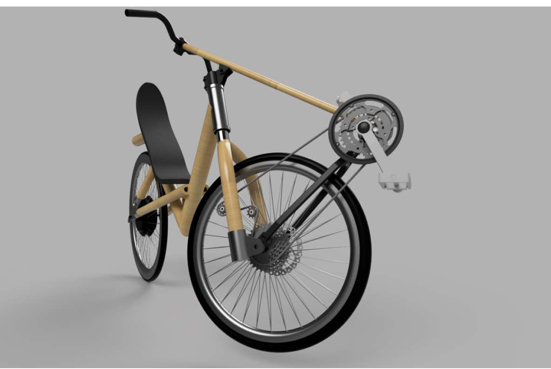
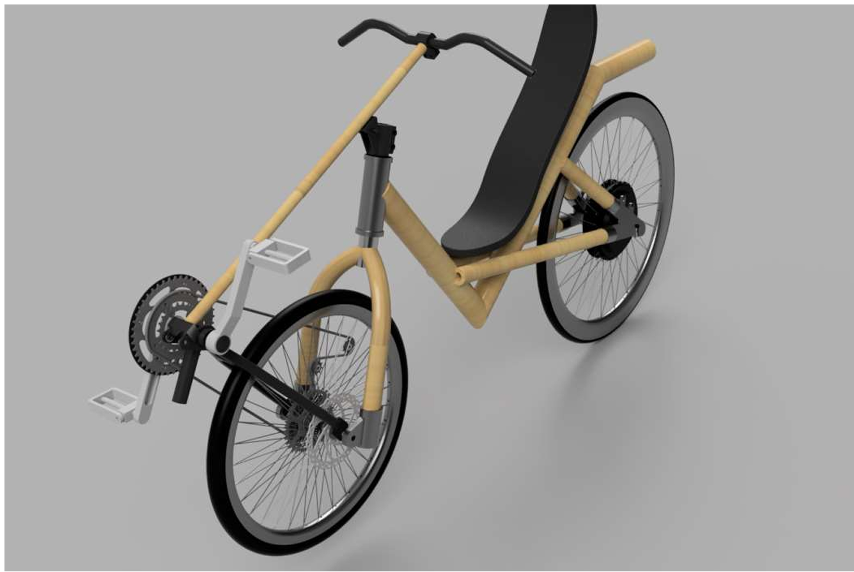
SolidWorks Model

Slide 3
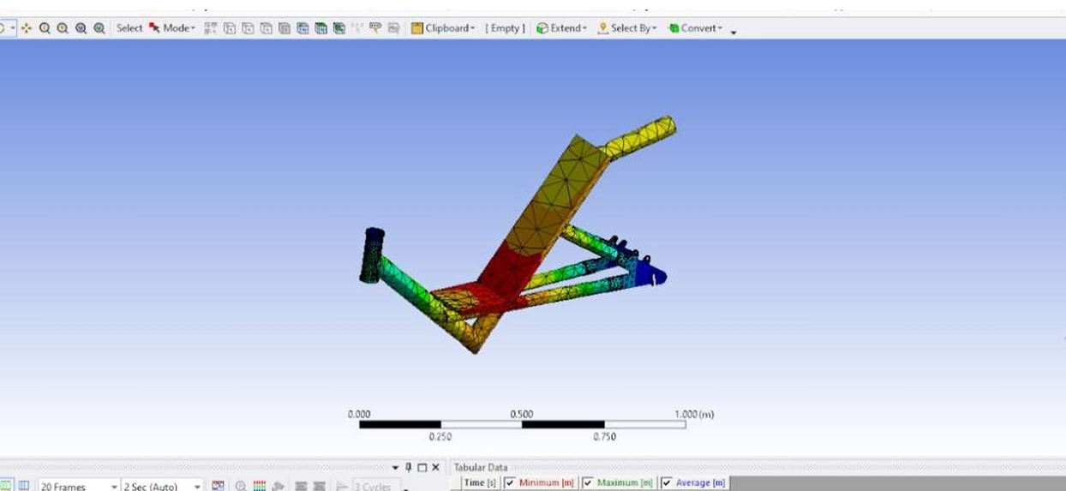
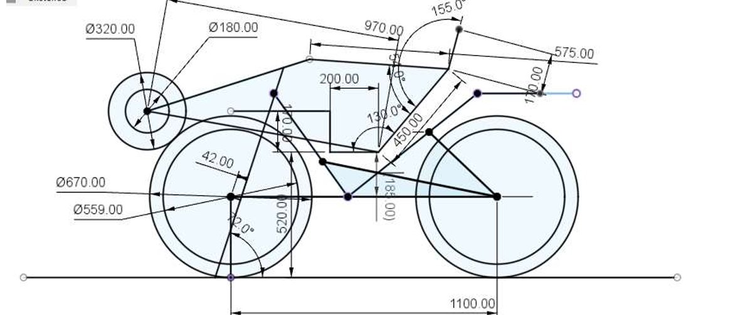
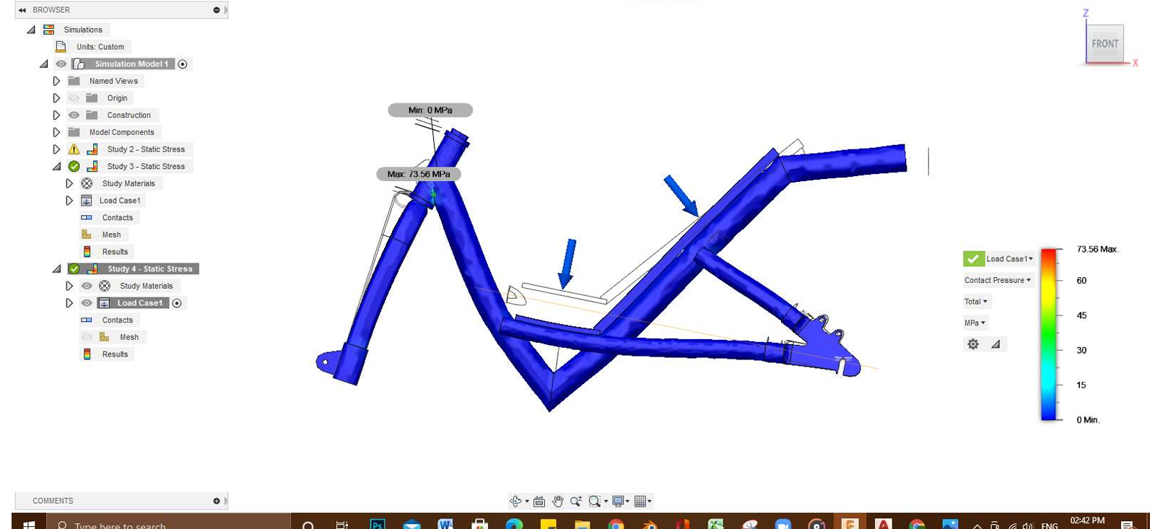
Geometric Design and Analysis

Slide 4
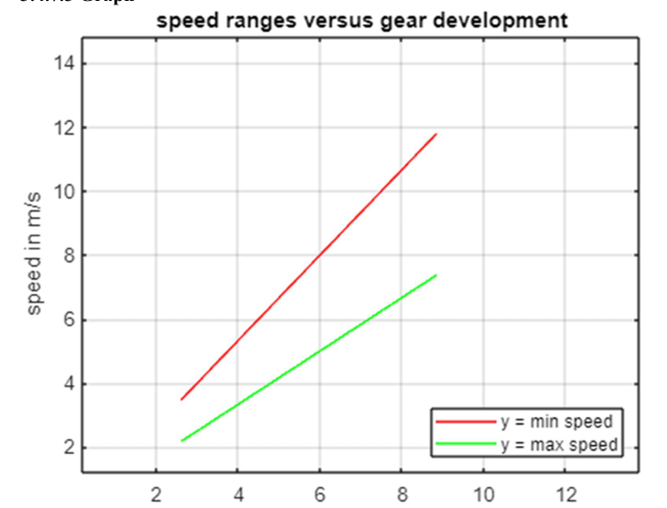
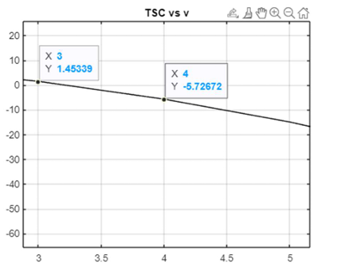
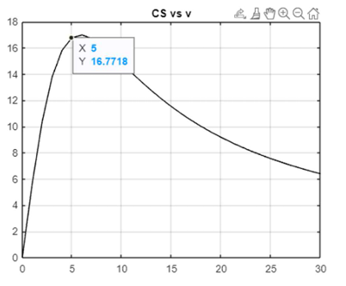
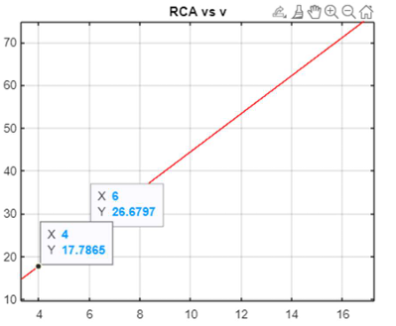
Patterson's Method
Speed v/s Gear development
Tortional Spring Constant v/s Velocity
Control Sensitivity v/s Velocity
Roll Control Authority v/s Velocity

